Slide 1
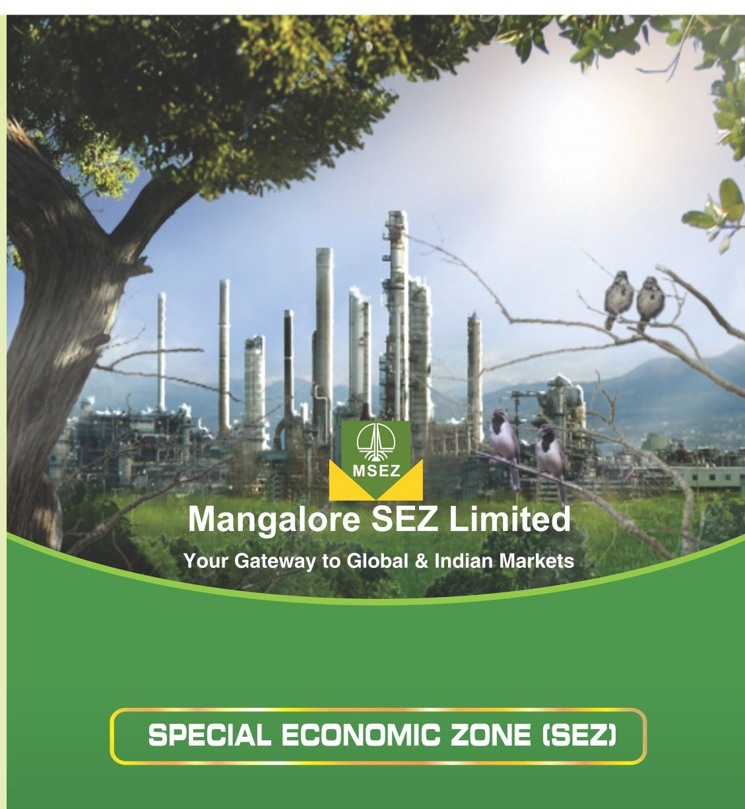
MULTI-PRODUCT

Slide 2


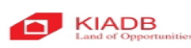


MSEZL – Company Profile and Structure
Mangalore SEZ Ltd (MSEZL) is an SPV incorporated in February 2006, with the objective of developing a “multi-product” SEZ.
Non Government company structure.
Composition of the Board – Nominees from ONGC (4), IL&FS (4), KIADB (1), KCCI(1) and 2 Independent Directors (one from Govt.of Karnataka).
Chairman is from ONGC.
Unique combination of Central and State Government entities along with industry body and financial institution.
1st Phase :- Notification for sector-specific (Petroleum / Petrochemical) SEZ received in November 2007. Upgraded to “Multi-Product” SEZ in Sep.’13

Slide 3
MSEZL – Evolution
Incorporated in Feb 2006, with the objective of developing a state-of-the-art Special Economic Zone in Mangalore that could primarily cater to the fast growing global and domestic market for Petroleum, Petrochemical & Specialty Chemicals
2006
Notified as a sector specific SEZ (petroleum and petrochemical)
Environmental clearance obtained
2008
MSEZL is the best and well developed manufacturing oriented SEZ in Karnataka
Land acquisition substantially completed
Commenced development & relocation of displaced people
2009
R&R colonies development substantially completed
2011
Zone has been upgraded into a “Multi-Product” SEZ with the sanction of the Board of Approval in the Department of Commerce, GoI in September,2013
2013
First tranche of external infrastructure completed
Formally declared ”Operational SEZ”
2014

Slide 4
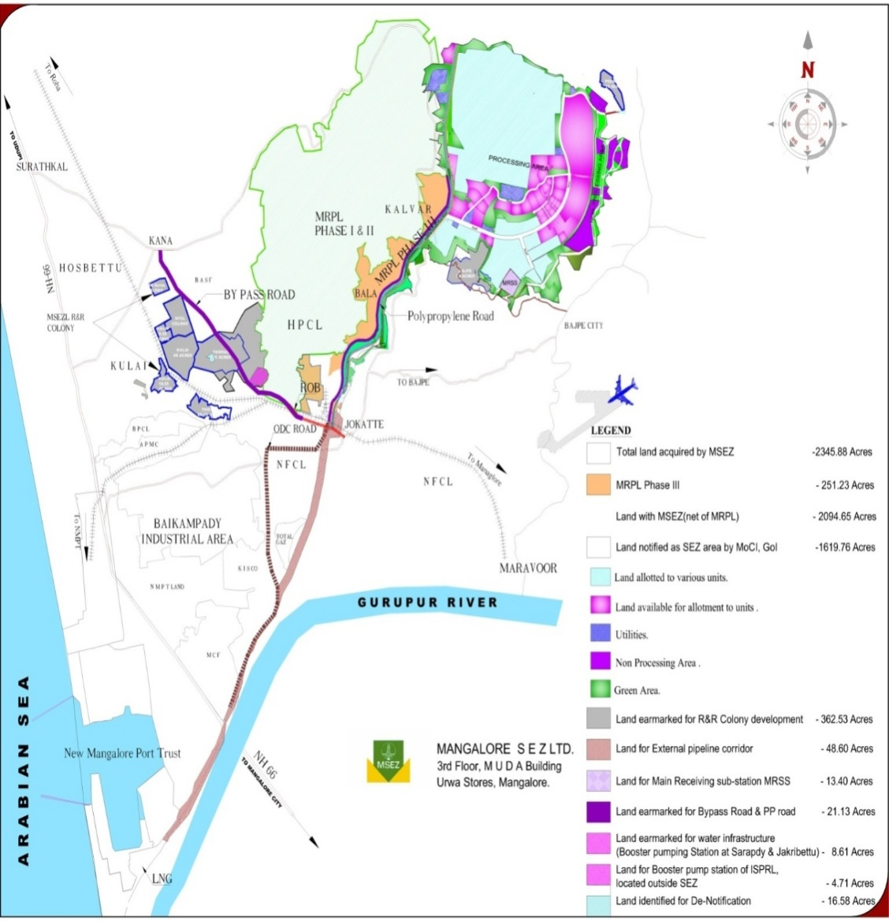
Location & Connectivity
Connected to 3 National Highways
NH 48, Mangalore to Bangalore
NH 66, Mumbai to Cochin
NH 13, Solapur to Mangalore
1
Mangalore International Airport is 5 kms away from MSEZ
Provides direct access to Middle East countries & major Indian cities
2
New Mangalore Port is just 8 kms
Connects developed countries across the globe
Deepest in west coast (15mt draft)
3
Connected to 3 Railway Network
Konkan Railways
South Western Railways
Southern Railways
4

Slide 5
MSEZL – Provides a Quick Start Advantage
Quick Start Advantage
Plug and Play Infrastructure
Feed Stock Availability
Clear Land Title
Environment Clearance
  Robust industrial infrastructure with planned social infrastructure
  From neighboring companies
  Companies with in SEZ
  Duty-free imports from Middle East
Acquired through
Govt of Karnataka
  Overall Environment Clearance for the SEZ from Ministry of Environment & Forests in place
  Units need to take state level clearances

Slide 6

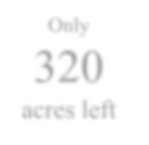
MSEZ : Master Plan
Only
154
acres left in Zone
DTA Plots available
SEZ Plots available
Plots already allotted
Committed Green area
6

Slide 7
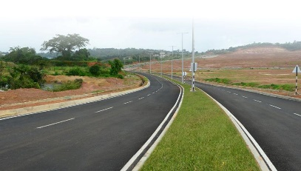
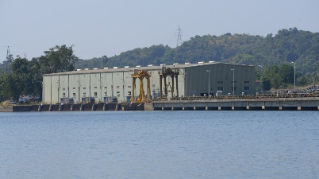
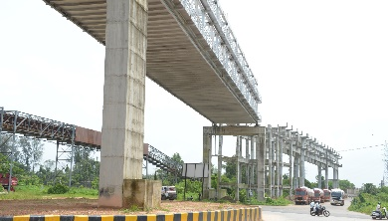
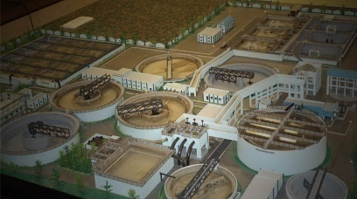
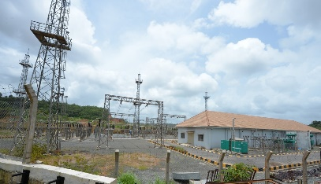
MSEZL – State of the Art Infrastructure Facilities
Well planned wide roads
Well planned wide roads -50 mtrs, 35 mtrs, 24 mtrs
Street lighting and watch towers
Abundant water supply from river source
27 MGD water sanctioned by Karnataka Govt. from rivers of Nethravati and Gurupur
Infrastructure for pumping water from Nethravathi to SEZ is in place
Pipeline-cum-road corridor connecting to port
Direct connectivity to Mangalore Seaport to SEZ with a pipeline-cum-road corridor
Effluent collection, treatment & disposal network
Common Effluent Treatment Plant
Re-distribution of treated water to industrial units
Reliable power supply from state grid
Reliable power sourcing from state grid through 220 KV Sub-Station
MSEZL is a deemed Distribution licensee for supplying power in SEZ.
Supply at 110/33/11 KV through automated Sub-Station

Slide 8
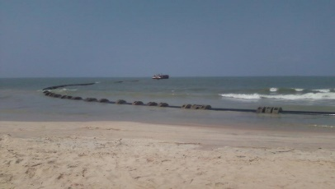
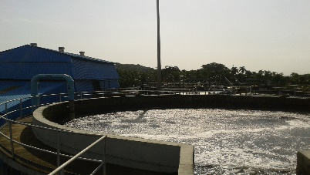
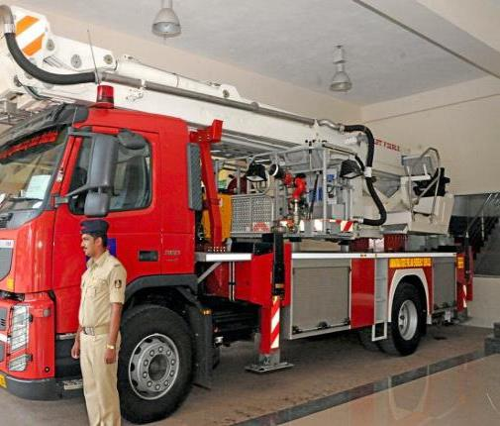
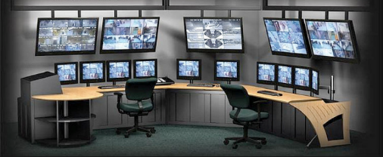
MSEZL – State of the Art Infrastructure Facilities
Marine Outfall Discharge
Treated waste water disposal pipeline from project to 1.2 kms inside the sea
First of its kind TTP in India with a present capacity of 5 MGD⁽¹⁾
Sourcing water from secondary treated sewerage treatment plant
Additional water storage of 120 ML for treated water within SEZ
Fit for industrial use
Tertiary Treatment Plant
Fire Fighting
Solutions
Fire fighting ring main network of 4.3 kms with pressurized pipeline
3 fire tenders of varied specifications of water, foam and powder
Secured Zone
24*7 CCTV surveillance & security system

Slide 9
Other Infrastructure in the SEZ
  Internal corridor connects the various industries in MSEZL. i.e. feedstock to intermediary to downstream
Internal Corridor
  Internal road network comprises a web of 4 and 2 lane roads with adequate storm water collection and disposal and drainage system
  street lighting and watch towers
Road
  MSEZL is developing a Green Belt covering 33% of the area
  Individual units are not required to develop green belt separately
Green Belt
  Developed a firefighting ring main system all along the roads and created common fire water storage reservoir and pumping system
Security

Slide 10
Snapshot of Investment, Exports, Employment generated in MSEZ and its Units March, 2026
Sl. No. | Name | Land allotted (in acres) | Investment in Rs Cr | Cum. Exports in Rs Cr. From 2014 | Employment (Direct + Indirect) | Status
1. | MSEZL | - | 1,669 | - | 410 | Developer
2. | MRPL –Aromatic unit | 442.48 | 7,338 | 61,583 | 908 | Operational
3. | ISPRL | 226.81 | 1,209 | 17.61 | 90 | C0-Developer / FTWZ
4. | Cardolite | 15.43 | 229 | 3036 | 196 | Operational
5. | Authentic Oceean Treasure | 3.66 | 54 | 1144 | 270 | Operational
6. | GMPL (JBF) | 115.30 | 5,995 |  | 288 | Unit under revival
7. | Syngene | 46.42 | 365 | 220 | 328 | Operational
8. | Catasynth | 20.00 | 312 | 25 | 212 | Operational
9. | Gadre Marine Exports | 11.50 | 184 | 914 | 500 | Operational

Slide 11
Snapshot of Investment, Exports, Employment generated in MSEZ and its Units March, 2026
Sl. No. | Name | Land allotted (in acres) | Investment in Rs Cr | Cum. Exports in Rs Cr. From 2014 | Employment (Direct + Indirect) | Status
10. | Shree Ulka LLP | 10.16 | 66 | 1204 | 109 | Operational
11. | Yashaswi Fish meal | 7.07 | 165 | 1023 | 566 | Operational
12 | ETAG Energietechnik | 2.21 | - | - | - | MOU entered on 27.03.25
13 | MIR Suncol BIPV | 5.00 | - | - | - | MOU entered on 15.05.25
14 | Nuwill Research | 6.00 | - | - | - | MOU entered on 30.03.26
 | Sub –Total | 912.04 | 17,586 | 69,167 | 3877
12 | DTA units 2 (No’s) | 7.5 | - | - | - | Mou’s entered – Land not given
 | Total | 919.54

Slide 12








Suitable Sectors
1
PETROLEUM & PETROCHEMICAL PRODUCTS
Strong affinity to the industry
Good backward & forward linkages
6 1
Manufacturing &Others
Petroleum & Petrochemical Products
2
PLASTICS
Feedstock availability from units within SEZ
5
2
3
IT & ITES / FINANCIAL CENTER
Strong presence of IT/ ITES companies
Very close to urban settlement
Textile
Plastics
4
PHARMA
Good Port connectivity for easy logistics
Chemical companies in the proximity
4
3
Pharma
IT & ITES
5
TEXTILE
Good backward linkages
6
MANUFACTURING & OTHERS
Logistics / warehousing
Gems & Jewellery
37

Slide 13
Project Photographs

Slide 14
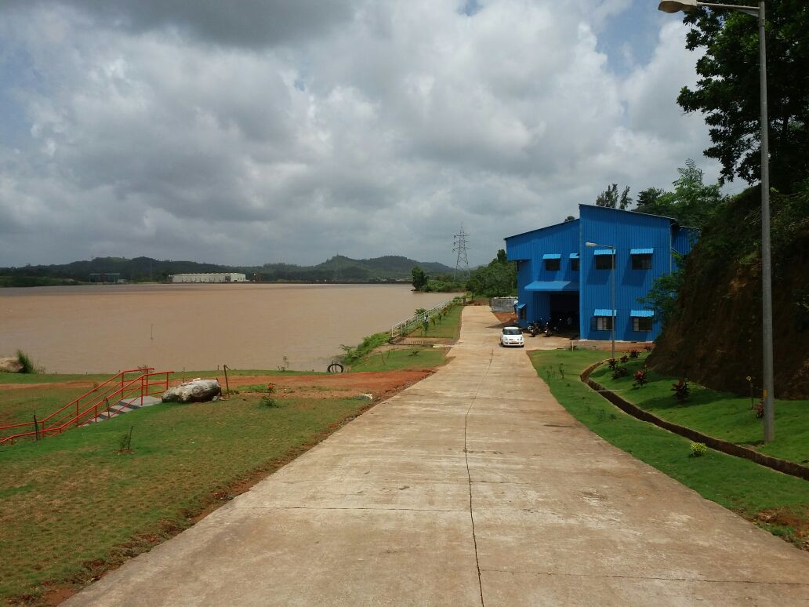
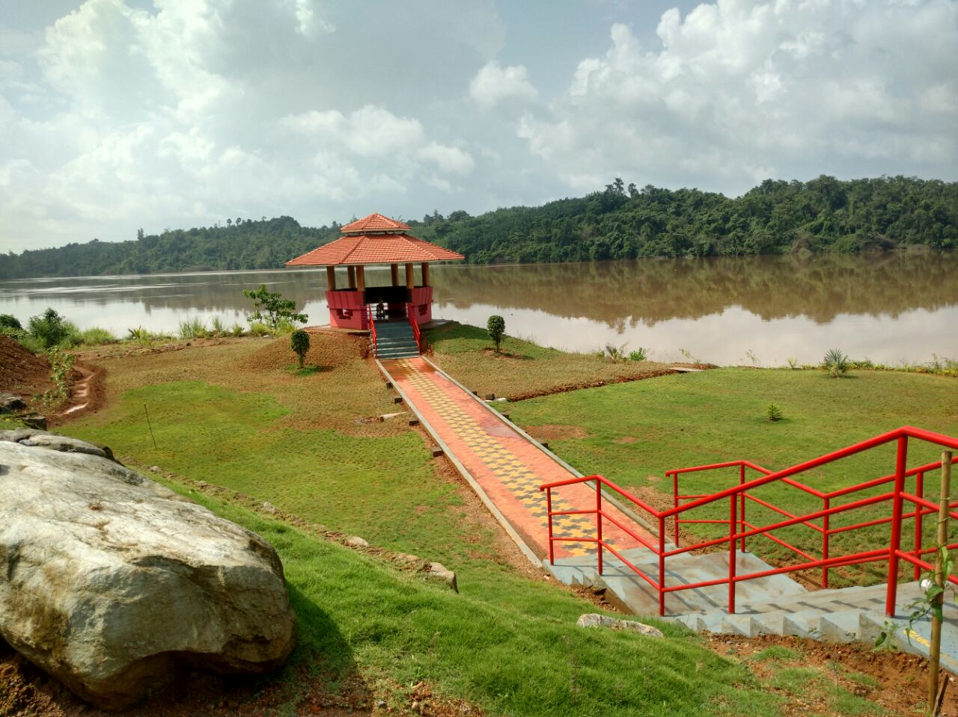
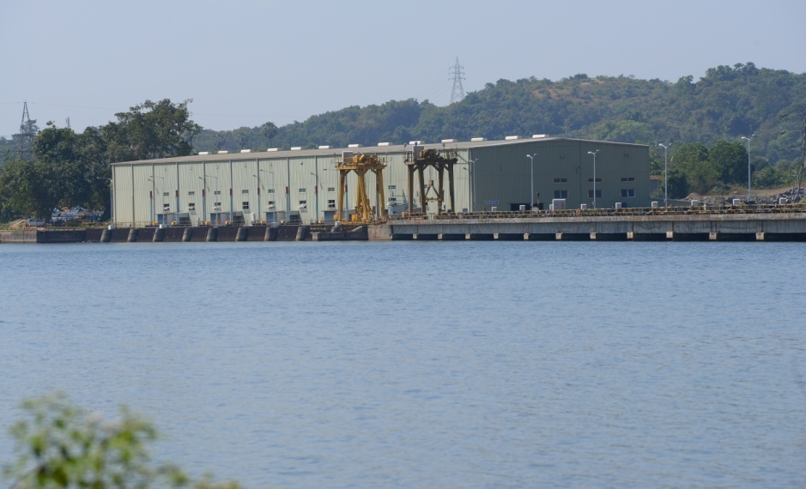
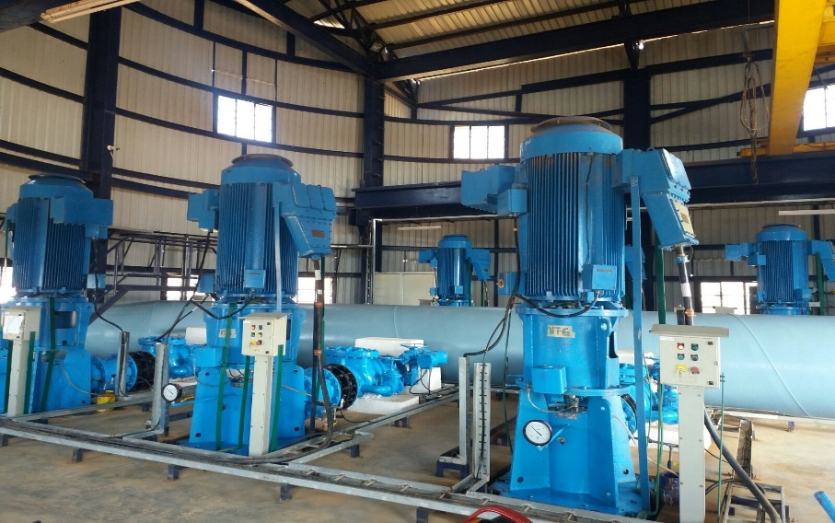
River Water Infrastructure

Slide 15
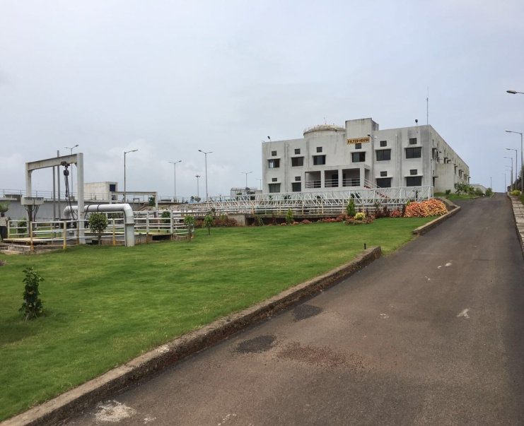
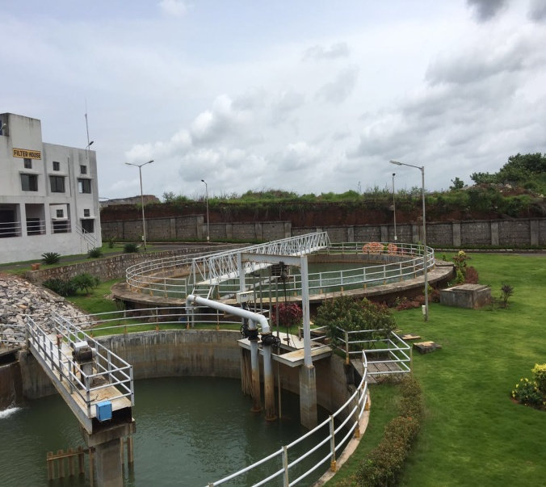
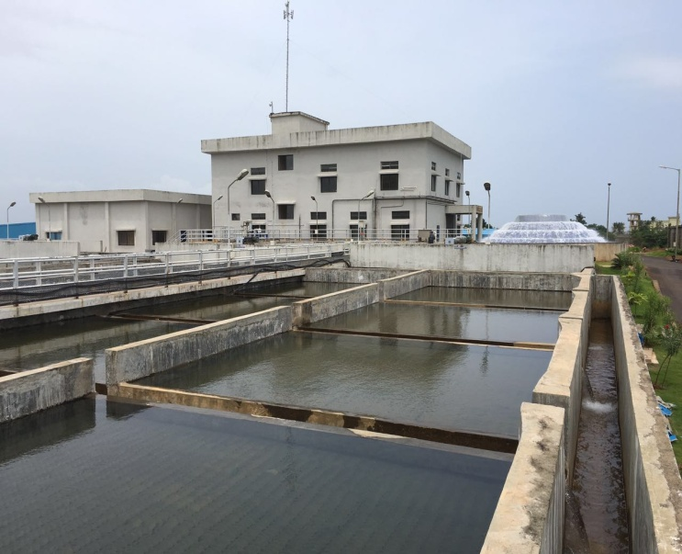
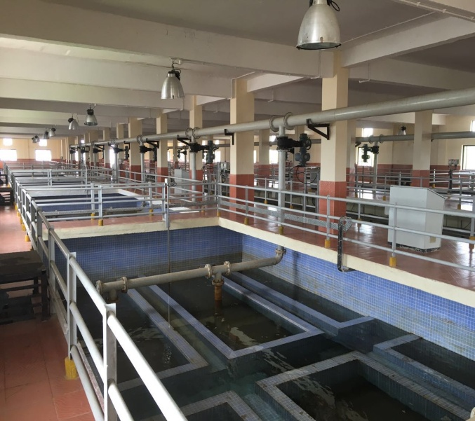
Water Treatment Plant (WTP)

Slide 16
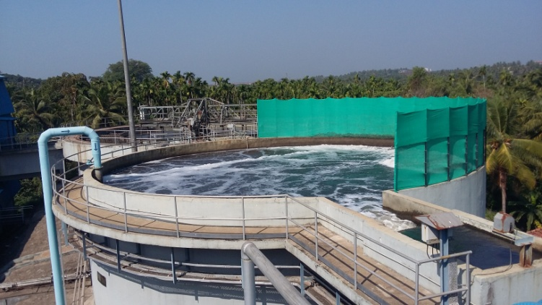
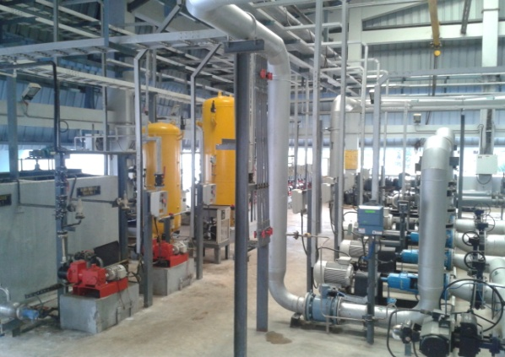
Tertiary Treatment Plant

Slide 17
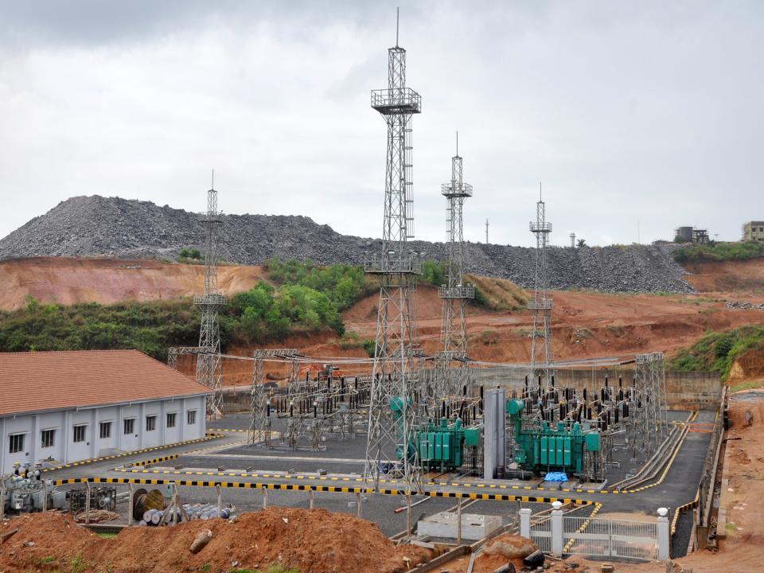
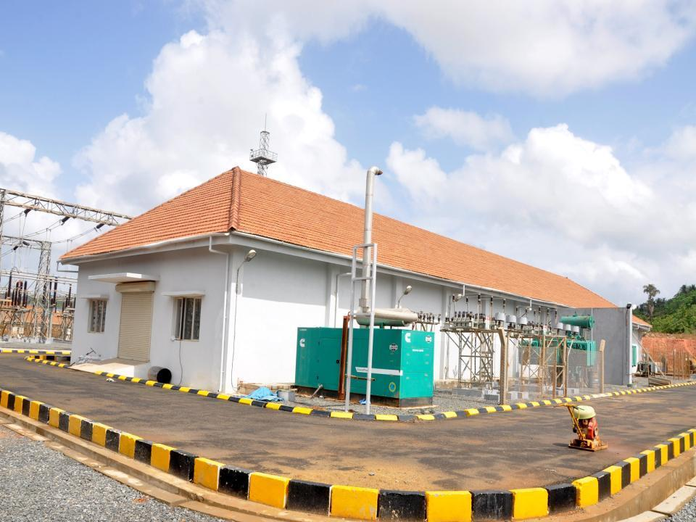
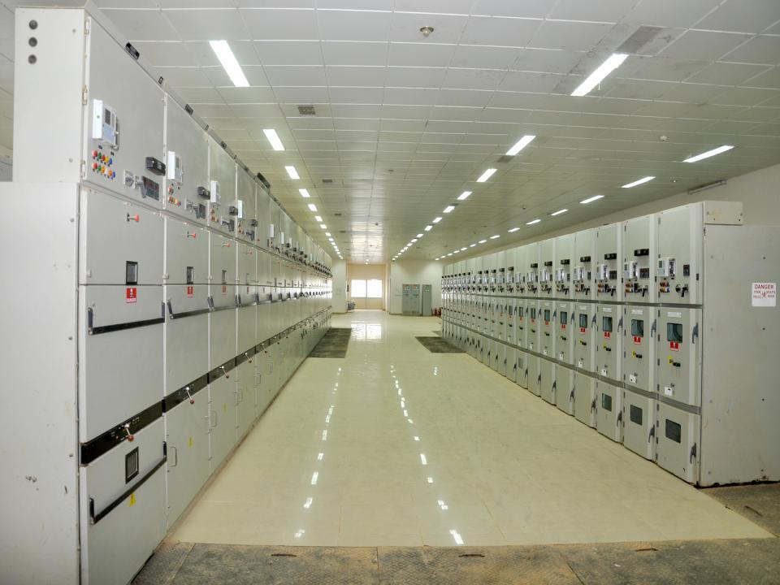
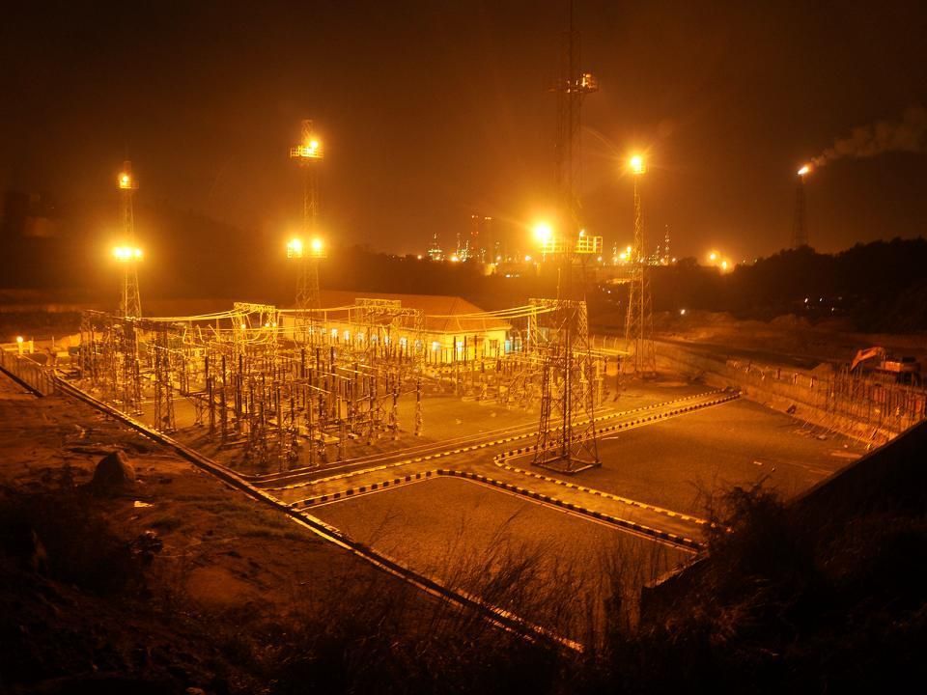
Power Infrastructure

Slide 18
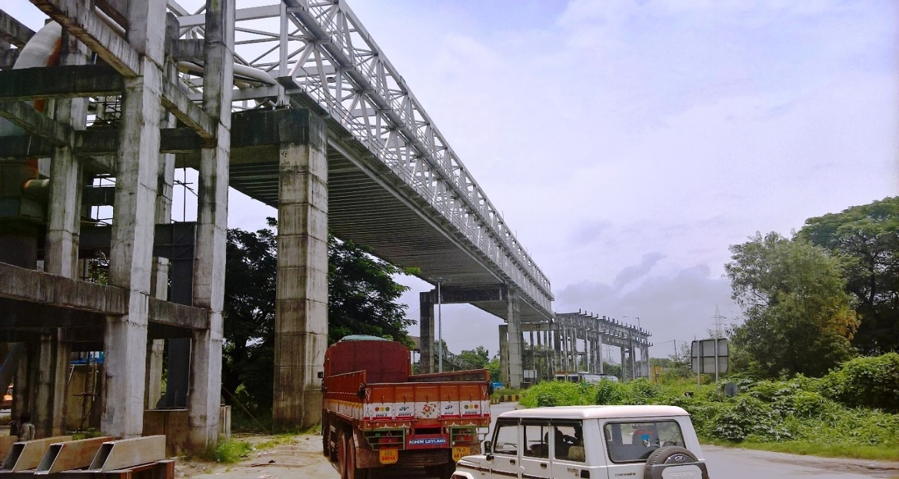
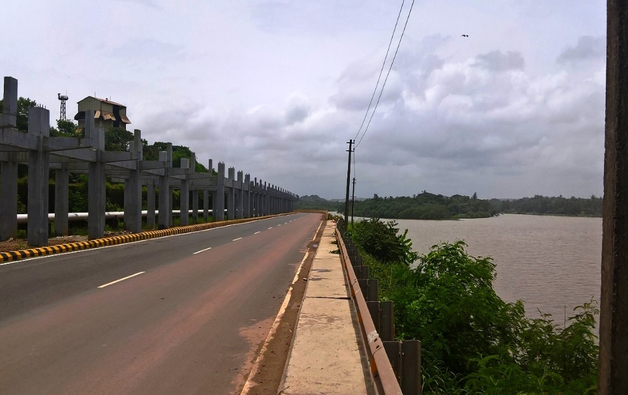
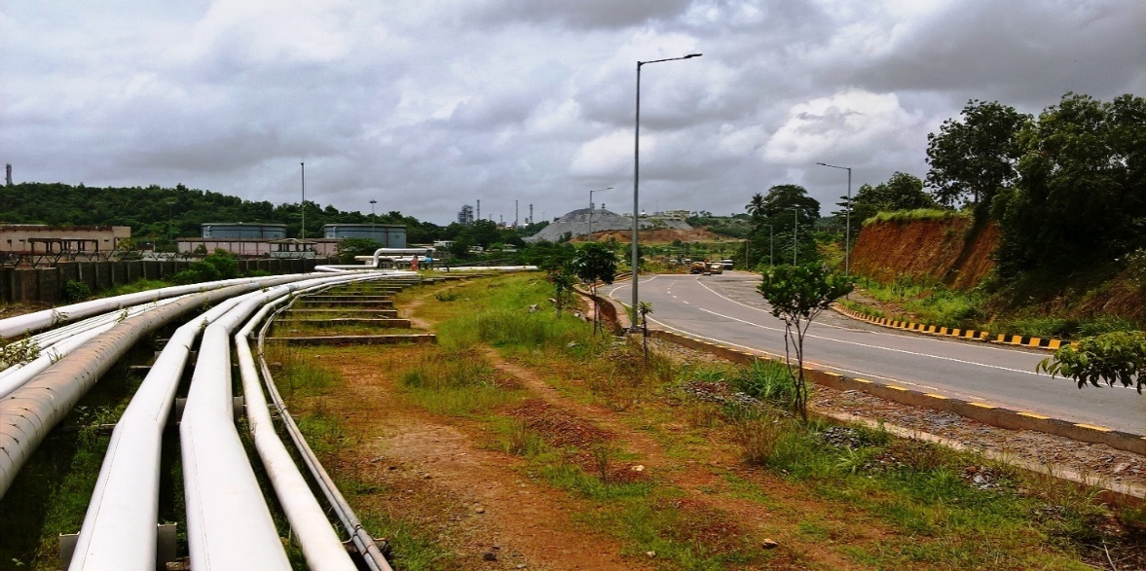
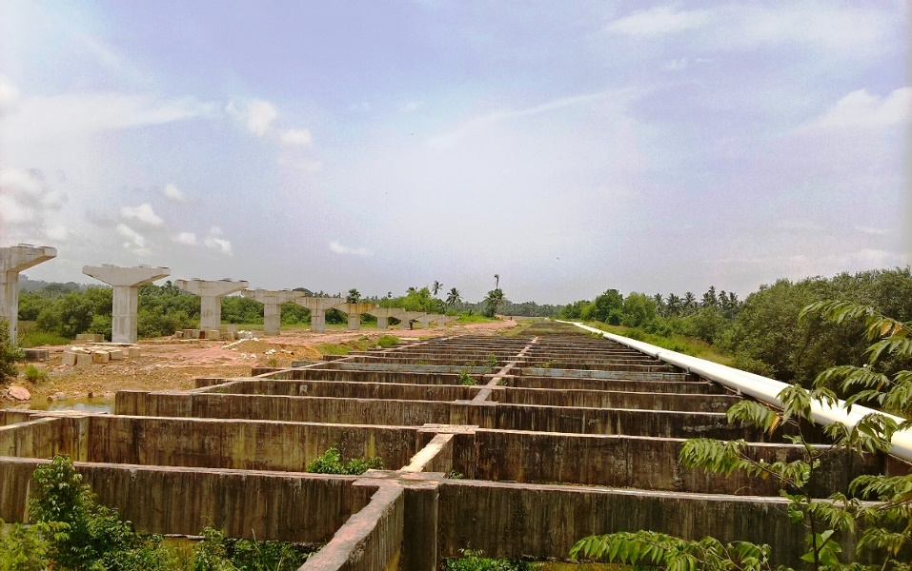
Corridor Infrastructure

Slide 19
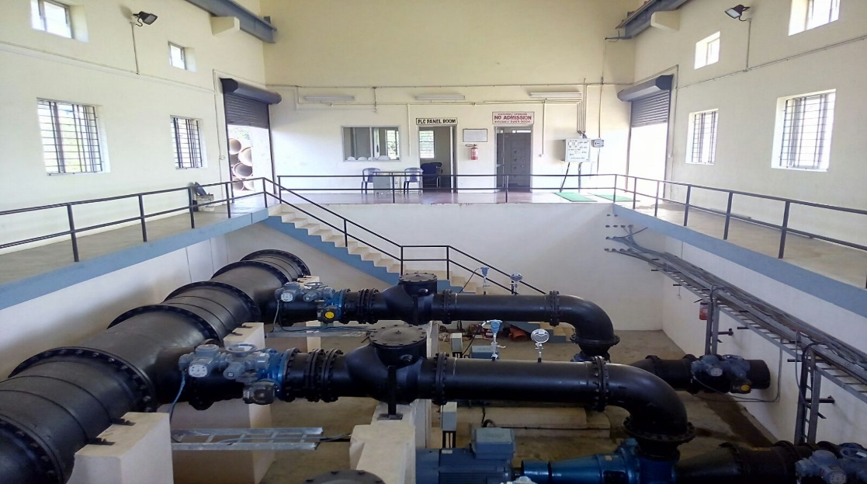
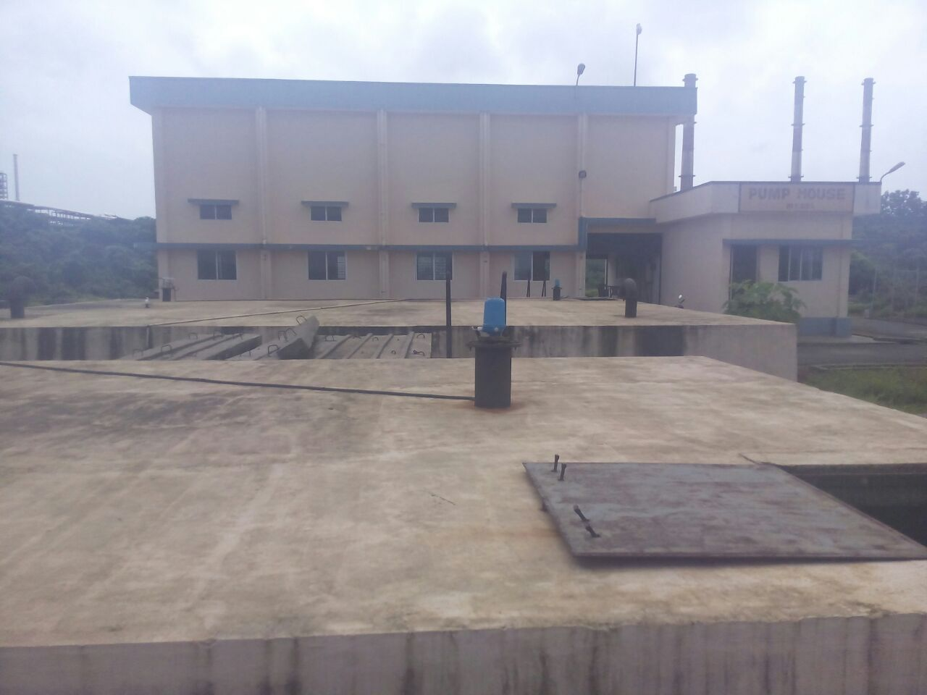
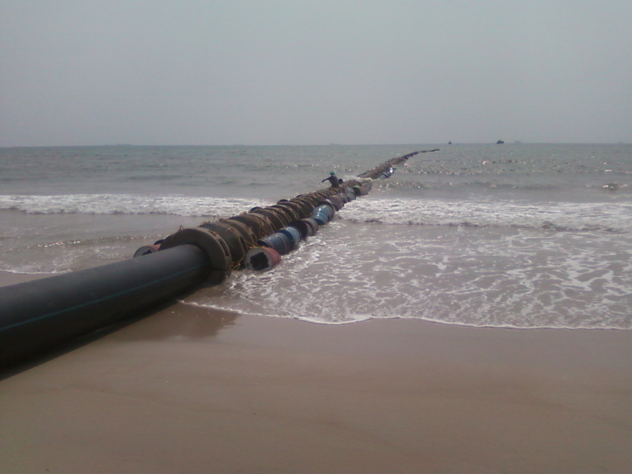
Marine Outfall

Slide 20
THANK YOU

Slide 21
Commercials ( 2026-2027)
Sl. No. | Particulars | Rupees | Annual Escalation | Remarks
1 | Land on Lease | 2.26 Cr per acre (One time Non refundable Lease Premium) | 4% | Lease up to 26.01.20260 extendable up to Max 99 Years
2 | Lease Rental | 1.28 Lakhs per acre per annum | 2.5%
3. | River Water | 63.25 per KL | 4%
4 | Zone O&M | 5.34 per sq.ft per annum | 3% | Plus Rs 1.43 per sq.ft for road overlay as and when taken up
5 | Marine outfall | 37.15 per KL | 4.5%

